Slide 1
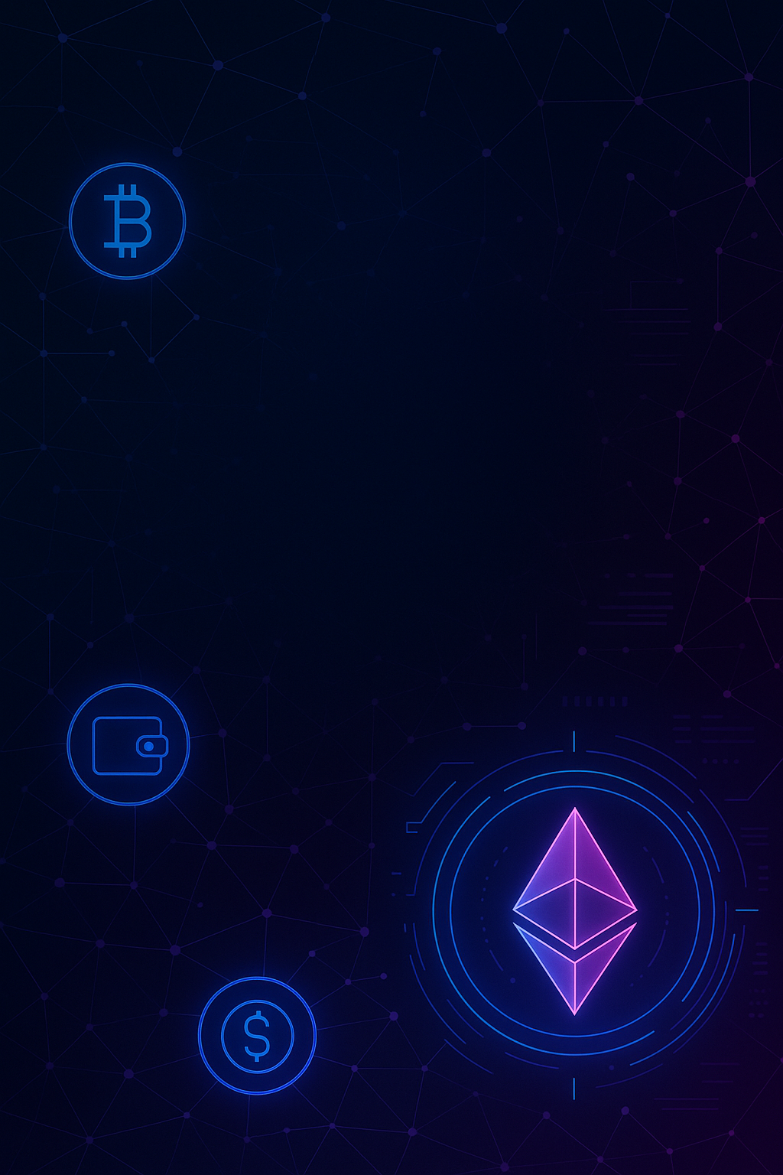

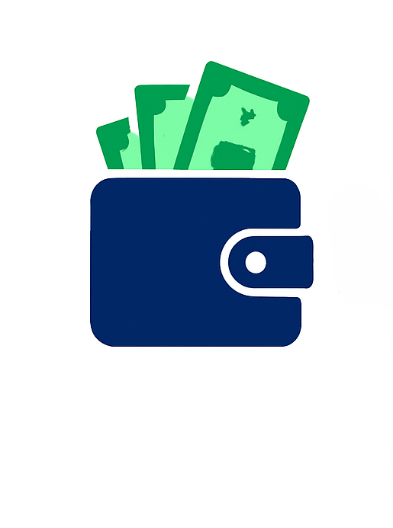

WalletWise
Managing Funds, Exploring Web3
OUR TEAM
Aaryan (2311981009)
Akshat Prashar (2311981048)
QR Code: Link for GitHub

Slide 2


INTUITIVE WALLET MANAGEMENT
Simplify your digital finance experience with FundFlow's clean interface. Easily manage your balance, track transactions, and handle simulated payments without unnecessary complexity.
MODERN TECHNOLOGY INTEGRATION
Leverages Supabase for real-time data and secure authentication. Explore simulated Web3 payments via MetaMask integration with an Ethereum (Holesky) smart contract. A practical demonstration of modern web development.
UNSDG GoaLs
Goal 9: Industry, Innovation, and Infrastructure
Goal 8: Decent Work and Economic Growth
SupervIsor
Dr. Navneet Kaur

